Slide 1
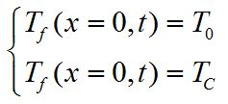
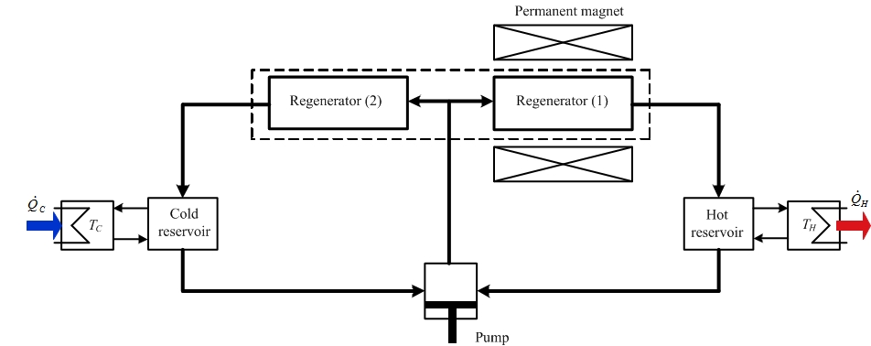
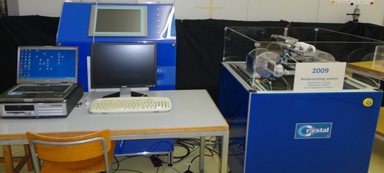
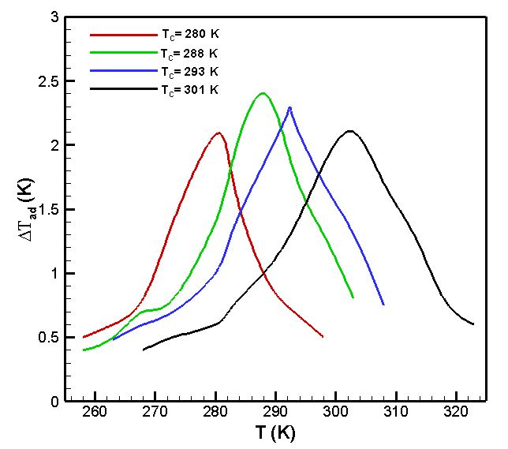
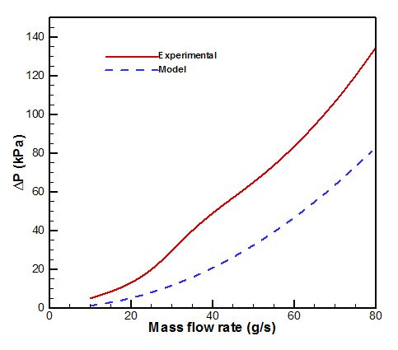
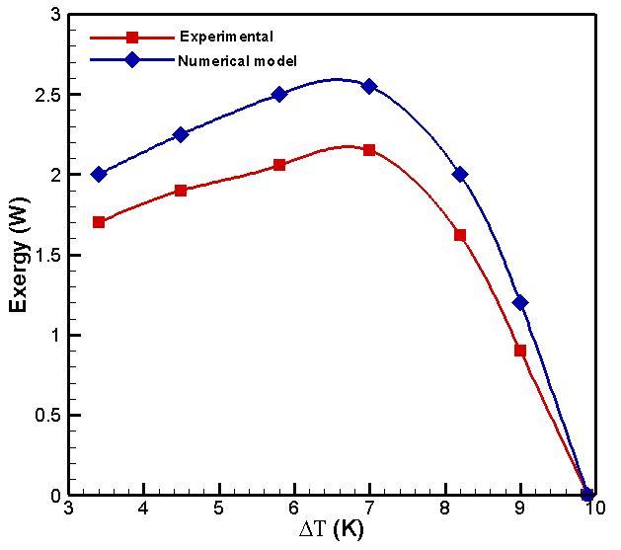
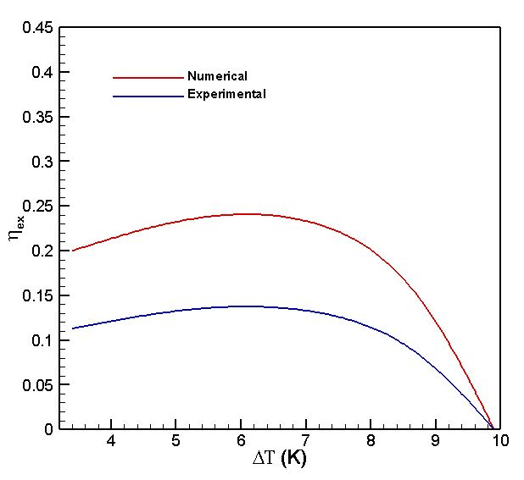
Experimental and numerical study on the behavior of a multilayer for active magnetic refrigerator based on La-Fe-Co-Si
Journée d’Etude sur l’Exploitation des Energies Renouvelables pour la Sécurité Energétique de l’Algérie, J3ERSEA’24, Médéa-Algérie, 10 Juin 2024
Younes CHIBA, ……………………………………
LERM, Mechanical Engineering Department, Faculty of Technology
University of Médéa, Médéa, 26000, Algeria
chiba.younes@univ-medea.dz
1. Abstract
The present work dedicated to study the experimental validation of a numerical model based on La-Fe-Co-Si layered operating near room temperature. For the purpose of this study , a numerical simulation based on the transient energy equations is proposed for modelling the heat exchange between the multilayer material and the carrier fluid in the regenerator bed with an applied magnetic field of 1.5 T. The main findings of the simulation show a comparison between numerical model and experimental set-up including magnetocaloric effect of La-Fe-Co-Si, pressure drop, exergy and exergetic efficiency.
2. The mathematical model and governing equations
For fluid
For multilayer
For refrigerator
3 Experimental Setup
Fig.2 Geometry and configuration of multilayer
Fluid | Water
Fluid Specific heat (J/gK) | 4.18
Total mass of solid material (g) | 716.76
Total mass of fluid (g) | 45.6
Magnetocaloric material | La(Fe,Co)Si
Type of magnetic source | Permanent magnet (NdFeB)
Magnetic field (T) | 1.45
Fig.1 Schematic diagram of the active magnetic refrigeration refrigerator setup built at HES-SO
Table1. Operating and technical parameter of demonstrator
Fig.3 Active magnetic refrigeration device built at HES-SO
4. Results and discussions
Fig.4. Variation of the adiabatic temperature change at different Curie temperature as function of temperature under magnetic field 1.5T
Fig.5. Evolution of pressure drop as function
of mass rate flow
Fig.6. Evolution of exergy as function of temperature span under magnetic field 1.5 T and 0.25 Hz frequency
Fig.7. Variation of the exergetic efficiency as function of temperature span under magnetic
field 1.5 T and 0.25 Hz frequency
5. Conclusion
The main objective of the work presented in this paper, is to study the behavior of a multilayer for active magnetic refrigerator and clarify the technical aspects of the technology based on La-Fe-Co-Si. The alloys of La-Fe-Co-Si were experimentally and numerically studied for AMR demonstrator at room temperature range. The difference of about 25 % has been noted between the experimental measurements and numerical predictions. For improving the efficiency of the demonstrator, it is suggested that we must minimize the losses in the hydraulic circuit. The obtained results enable us to clarify the behaviour of the AMR cycle based on La-Fe-Co-Si for describing the performance of a magnetic refrigeration device and the need to propose numerical models similar as mean field theory.

